Slide 1

HR DATA ANALYSIS
By Bittu Kumar

Slide 2
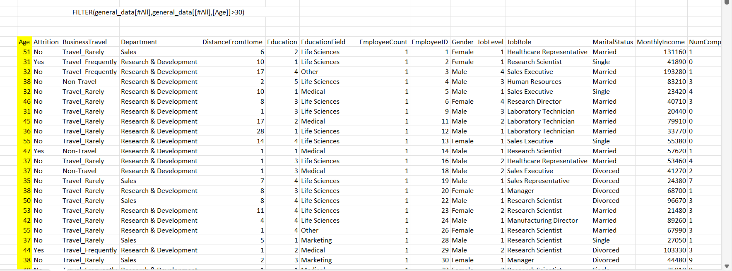
Using Excel, how would you filter the dataset to only show employees aged 30 and above?

Slide 3
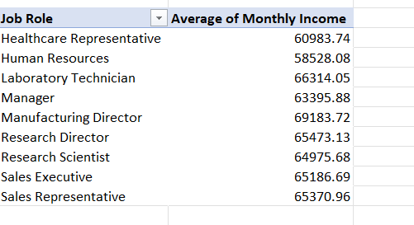
Create a pivot table to summarize the average Monthly Income by Job Role.

Slide 4
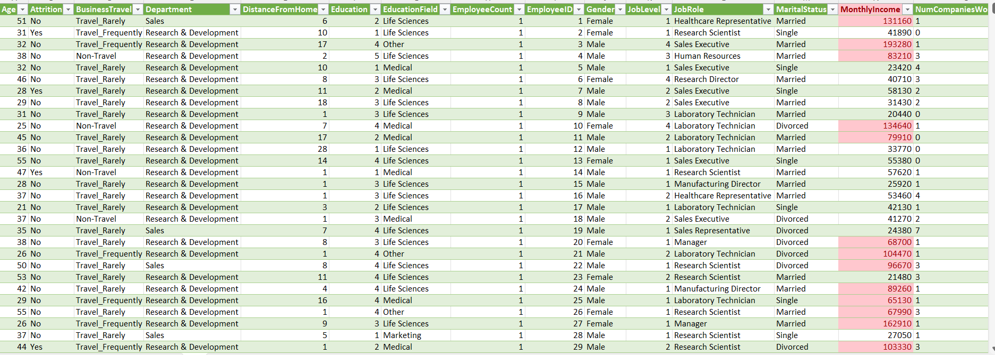
Apply conditional formatting to highlight employees with Monthly Income above the company's average income.

Slide 5
Create a bar chart in Excel to visualize the distribution of employee ages.

Slide 6
Identify and clean any missing or inconsistent data in the "Department" column.
There is no missing or inconsistent data in the "Department" column.

Slide 7
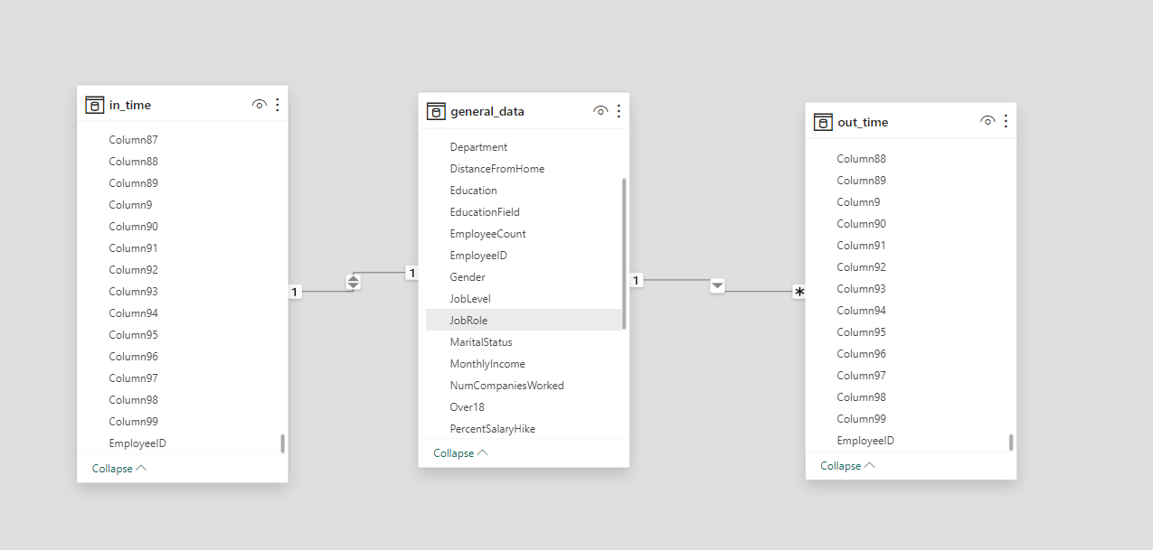
In Power BI, establish a relationship between the "EmployeeID" in the employee data and the "EmployeeID" in the time tracking data.

Slide 8
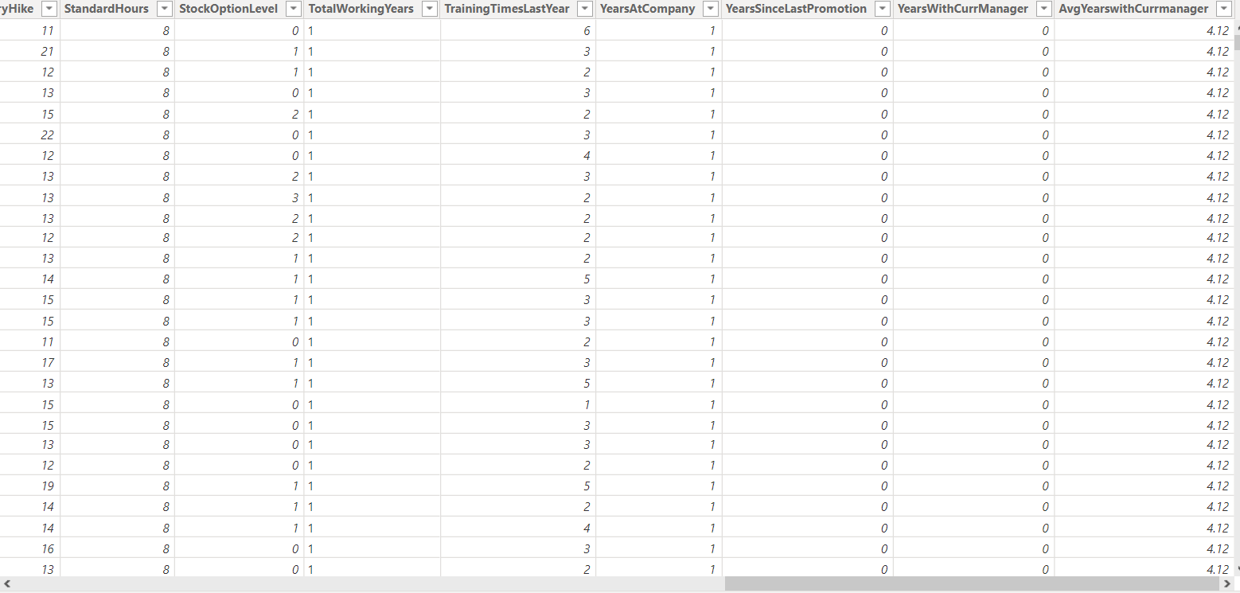
Using DAX, create a calculated column that calculates the average years an employee has spent with their current manager.

Slide 9
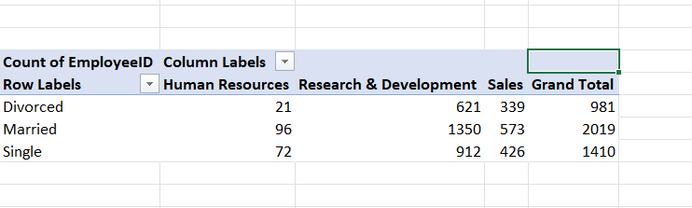
Using Excel, create a pivot table that displays the count of employees in each Marital Status category, segmented by Department.

Slide 10
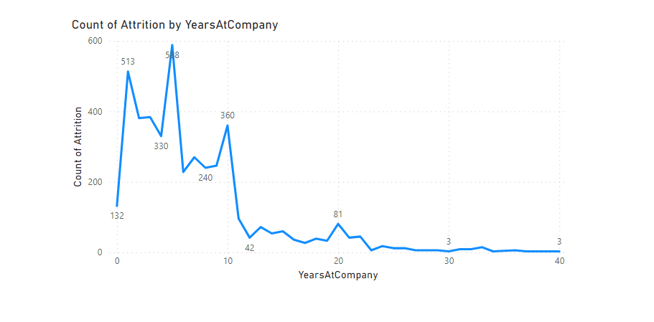
In Power BI, create a line chart that visualizes the trend of Employee Attrition over the years.

Slide 11
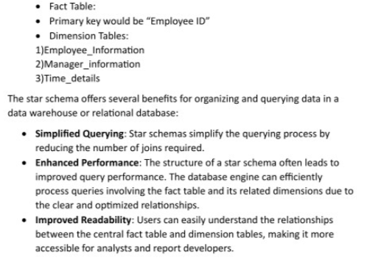
Describe how you would create a star schema for this dataset, explaining the benefits of doing so.

Slide 12
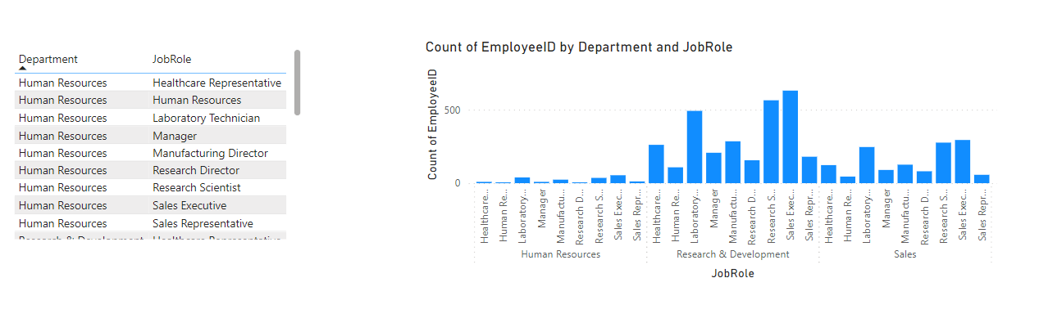
Create a hierarchy in Power BI that allows users to drill down from Department to Job Role to further narrow their analysis

Slide 13
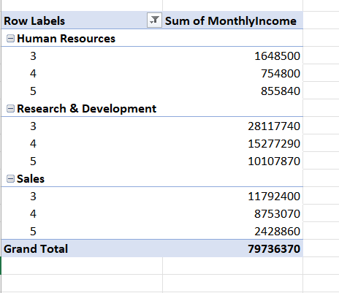
In Excel, calculate the total Monthly Income for each Department, considering only the employees with a Job Level greater than or equal to 3.

